Slide 1
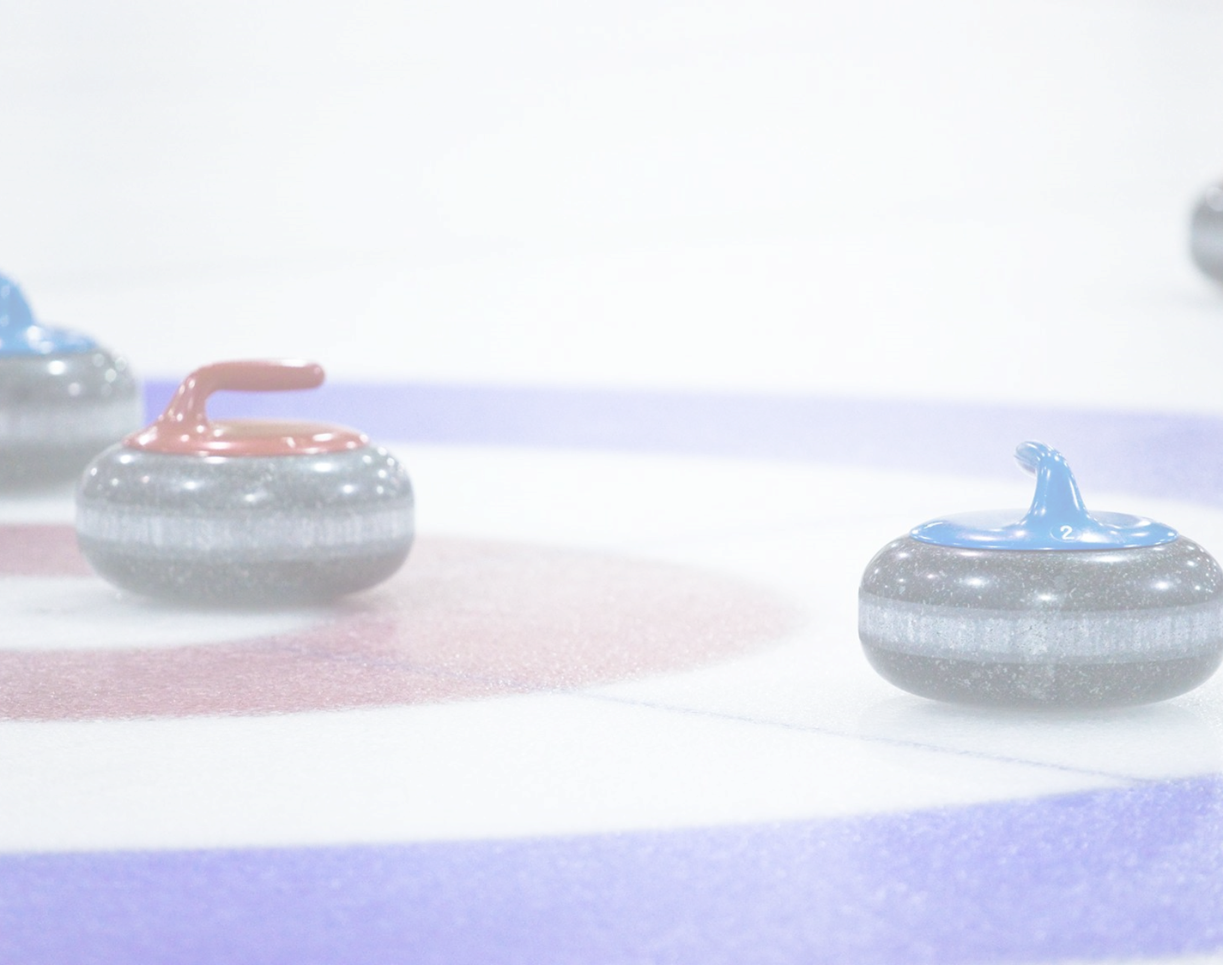
ECE 3760: Final Presentation
Team 1 Members:
Antony Zaky
Corben Kolaski
Mohammad Atari
Sukhmeet Singh Hora

Slide 2



Presentation Overview
1
Specifications: Sukhmeet
Make a big impact with professional slides, charts, infographics and more.
Project Motivation and Stakeholders
Design Specifications
2
Technology & Skip Device: Tony
Make a big impact with professional slides, charts, infographics and more.
Technology used
Skip Device Features
3
Sweeper Device: Mo
Make a big impact with professional slides, charts, infographics and more.
Display Signals
Sweeper Device Features
4
Marketing: Corben
Make a big impact with professional slides, charts, infographics and more.
Components and Costs
Market Overview and Business Strategy
5
Conclusion: Mo
Make a big impact with professional slides, charts, infographics and more.
Takeaways and future considerations
Audience Questions

Slide 3
Specifications
1
Specifications: Sukhmeet
Make a big impact with professional slides, charts, infographics and more.
Project Motivation and Stakeholders
Design Specifications
2
Technology & Skip Device: Tony
Make a big impact with professional slides, charts, infographics and more.
Technology used
Skip Device Features
3
Sweeper Device: Mo
Make a big impact with professional slides, charts, infographics and more.
Display Signals
Sweeper Device Features
4
Marketing: Corben
Make a big impact with professional slides, charts, infographics and more.
Components and Costs
Market Overview and Business Strategy
5
Conclusion: Mo
Make a big impact with professional slides, charts, infographics and more.
Takeaways and future considerations
Audience Questions

Slide 4



Problem Statement : To design a technology solution to help deaf curlers, especially to overcome the challenge of sweepers not being able to hear the skip yelling sweeping instructions.
Current Communication : using hand visuals
Design Solution : visual cues
Sweepers must look up at the skip periodically for hand signals.
Convey messages within the field of view of the sweeper
Sweepers may waste time checking for commands or miss them
Visual cues: distinct and intuitive patterns for different commands.
Less focus can cause the sweeper’s broom to hit a rock taking it out of play, hindering performance
Minimize changes to how the game is currently played
Doesn’t interfere with a player's ability to perform
Notes:
The devices are designed to enhance communication for deaf curlers and overcome the challenges faced by old techniques of communication like using hand visuals.

Slide 5
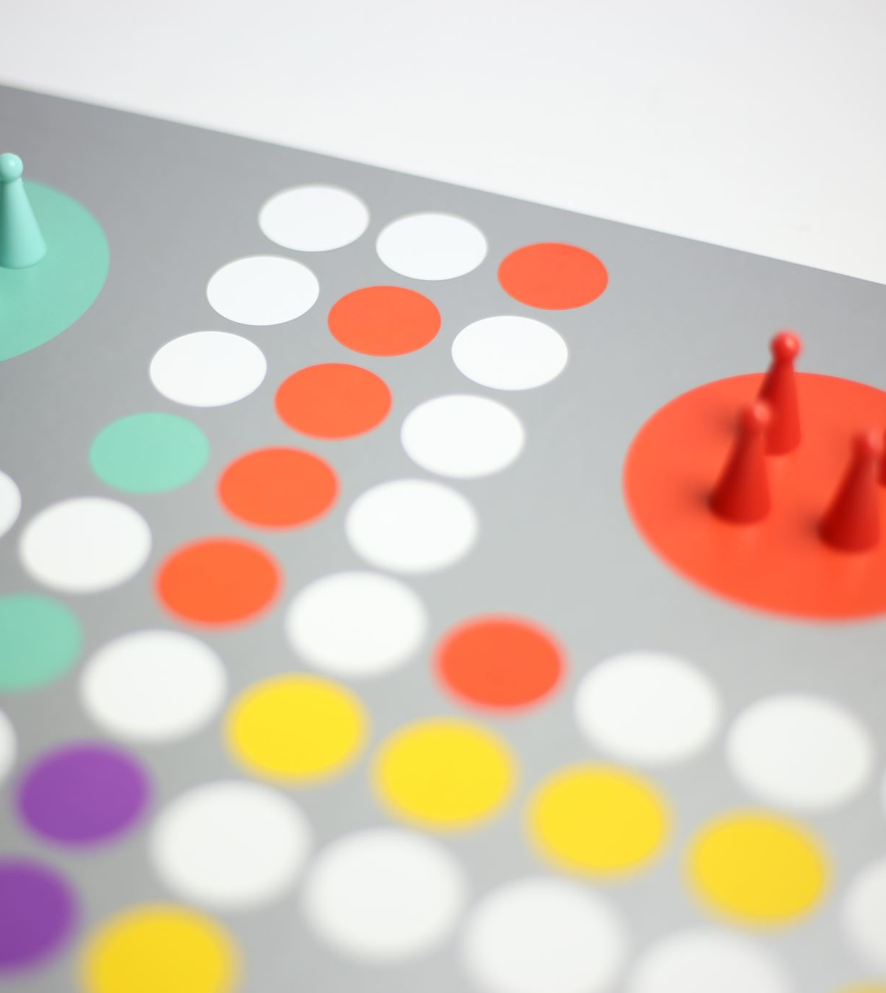
Specifications
Broom Buddy
Skip’s Single Handheld Controller
Sweeper’s Broom Mountable LED Ring
Real-time control over the game because of single input with precise and intuitive joystick mappings for direction and intensity.
Multiple easy to recognize patterns for different commands making it accessible for both deaf curlers and color-blind curlers and more intuitive.
The LED ring is always in the Sweeper's field of view.
Functions under operating conditions (cold temperatures, fast speeds, and forceful collisions (depending on the device placement))
The design connectivity covers the whole rink (150ft. or more)
Battery life lasts at least the length of a game (up to 3 hours)
Notes:
Optimized to eliminate unnecessary complexity and redundancy.

Slide 6
Metrics and goals
Design Objectives
Able to display messages from the skip within the field of view of the sweepers to allow the sweeper to retain focus.
Intuitive to use, minimizing time wasted by the curler in sending or deciphering messages.
Non-intrusive to the performance of the curler.
Customizable to satisfy the communication requirements and needs of a specific team.
Portable and modular to reduce inconvenience.
Adaptable to future design improvements.
Energy efficiency and maximizing battery life.
Durable to environmental conditions and reliable across repeated uses.

Slide 7
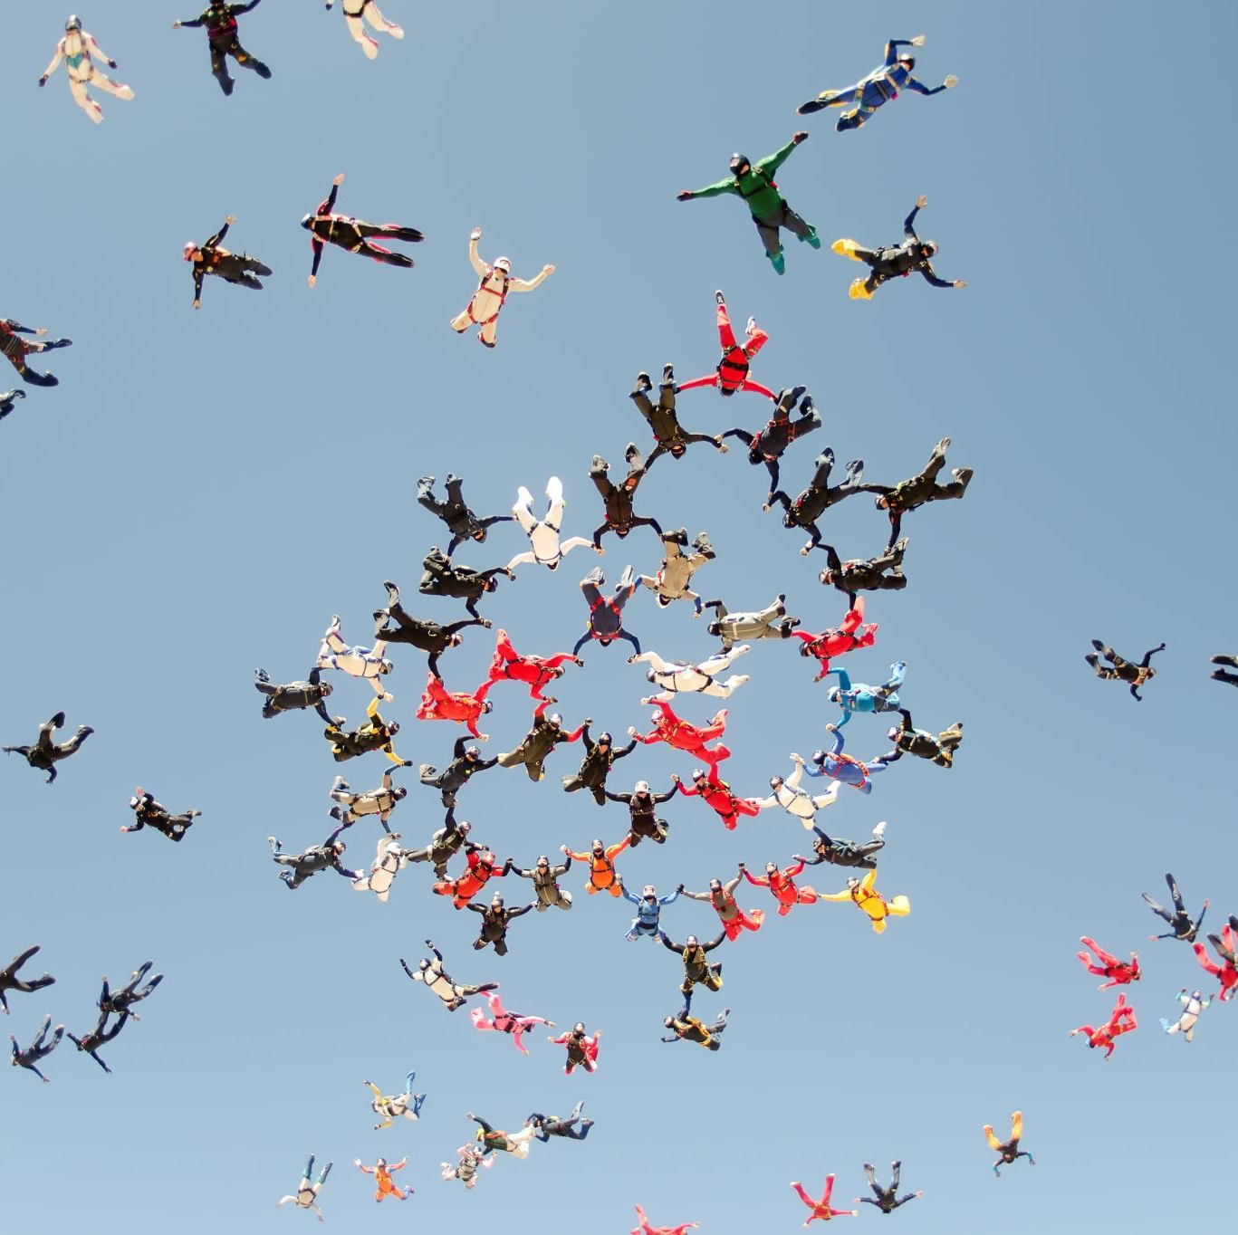
TARGET USERS Hard of hearing curlers, teams that include hard of hearing curlers, curling clubs and organizations and officials.
Core Stake Holders
Users: Hard of hearing curlers, and hearing curlers they interact with
Design Team 1
Design consultants such as the professor, teaching assistant and Examining panel
Component Manufacturers
Curling clubs and organizations.
Officials.
Notes:
Stakeholders are individuals, groups, or organizations that have an interest in or can be affected by the activities, decisions, or outcomes of a particular project, business, or organization.

Slide 8
Specifications
1
Specifications: Sukhmeet
Make a big impact with professional slides, charts, infographics and more.
Project Motivation and Stakeholders
Design Specifications
2
Technology & Skip Device: Tony
Make a big impact with professional slides, charts, infographics and more.
Technology used
Skip Device Features
3
Sweeper Device: Mo
Make a big impact with professional slides, charts, infographics and more.
Display Signals
Sweeper Device Features
4
Marketing: Corben
Make a big impact with professional slides, charts, infographics and more.
Components and Costs
Market Overview and Business Strategy
5
Conclusion: Mo
Make a big impact with professional slides, charts, infographics and more.
Takeaways and future considerations
Audience Questions

Slide 9
Technology & Skip Device
1
Specifications: Sukhmeet
Make a big impact with professional slides, charts, infographics and more.
Project Motivation and Stakeholders
Design Specifications
2
Technology & Skip Device: Tony
Make a big impact with professional slides, charts, infographics and more.
Technology used
Skip Device Features
3
Sweeper Device: Mo
Make a big impact with professional slides, charts, infographics and more.
Display Signals
Sweeper Device Features
4
Marketing: Corben
Make a big impact with professional slides, charts, infographics and more.
Components and Costs
Market Overview and Business Strategy
5
Conclusion: Mo
Make a big impact with professional slides, charts, infographics and more.
Takeaways and future considerations
Audience Questions

Slide 10
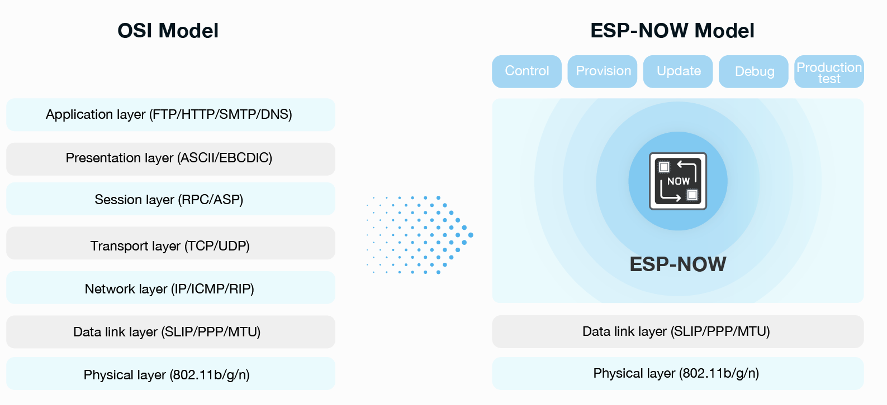
Technology Used & Power savings
Power Savings Techniques
Technology used
Limited Transmissions: Only transmit on a command change.
Transmission Power: Just enough to cover the playground.
Reduced Clock Frequency: We used less than 60% of the max CPU speed.
Turn on/off Button: Deep sleep mode entered for periods of inactivity or using the power button.
Additional methods investigated
Light sleep mode.
De-initializing ESPNow when light sleeping.
Stateless Transmission: ESPNow
Callback methods were implemented instead of polling.
12-bit Successive-Approximation ADC used to obtain joystick readings.

Slide 11
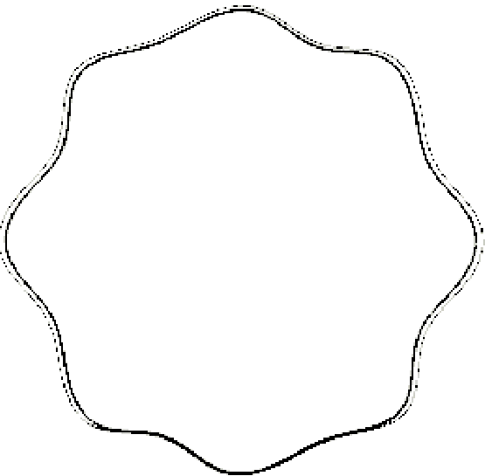
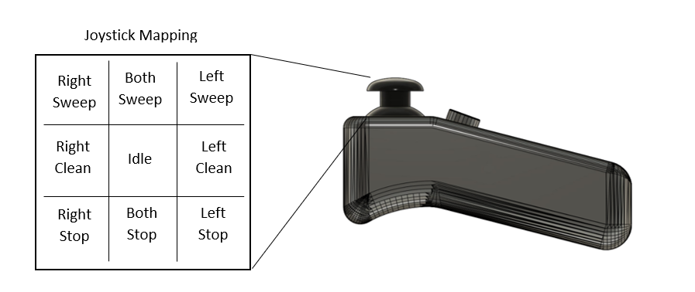
Skip Device
Octagonal Joystick Borders:
Skip feels the transitions between the commands.
Smoother corners for smoother transitions.

Slide 12
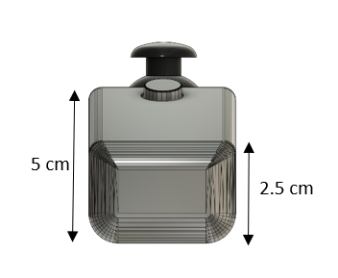
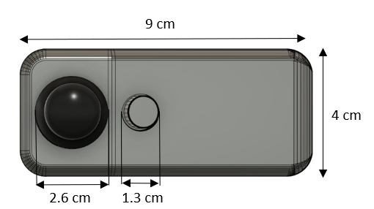
Skip Device Dimensions
5-seconds-hold to turn off: Eliminates the probability of accidental presses turning the device off.
Ergonomic design: Comfortable to hold for long periods of time and easier access to the Joystick.
Compact Size: Single hand held device.

Slide 13
Technology & Skip Device
1
Specifications: Sukhmeet
Make a big impact with professional slides, charts, infographics and more.
Project Motivation and Stakeholders
Design Specifications
2
Technology & Skip Device: Tony
Make a big impact with professional slides, charts, infographics and more.
Technology used
Skip Device Features
3
Sweeper Device: Mo
Make a big impact with professional slides, charts, infographics and more.
Display Signals
Sweeper Device Features
4
Marketing: Corben
Make a big impact with professional slides, charts, infographics and more.
Components and Costs
Market Overview and Business Strategy
5
Conclusion: Mo
Make a big impact with professional slides, charts, infographics and more.
Takeaways and future considerations
Audience Questions

Slide 14
Sweeper Device
1
Specifications: Sukhmeet
Make a big impact with professional slides, charts, infographics and more.
Project Motivation and Stakeholders
Design Specifications
2
Technology & Skip Device: Tony
Make a big impact with professional slides, charts, infographics and more.
Technology used
Skip Device Features
3
Sweeper Device: Mo
Make a big impact with professional slides, charts, infographics and more.
Display Signals
Sweeper Device Features
4
Marketing: Corben
Make a big impact with professional slides, charts, infographics and more.
Components and Costs
Market Overview and Business Strategy
5
Conclusion: Mo
Make a big impact with professional slides, charts, infographics and more.
Takeaways and future considerations
Audience Questions

Slide 15

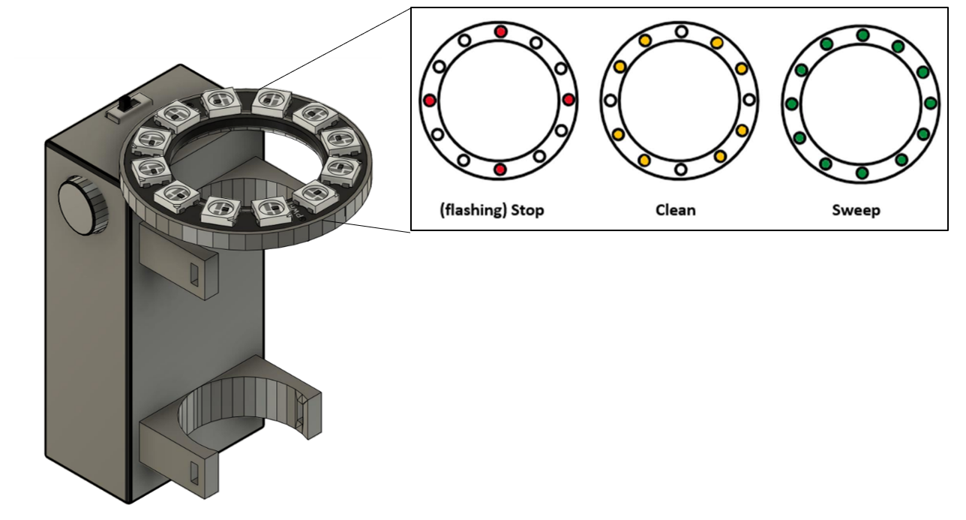
Sweeper Device
R
L
Simplistic & Unintrusive user interface
Intuitive colour mappings
Skip Idle state acknowledgment
Independent light patterns to accommodate colourblind users

Slide 16
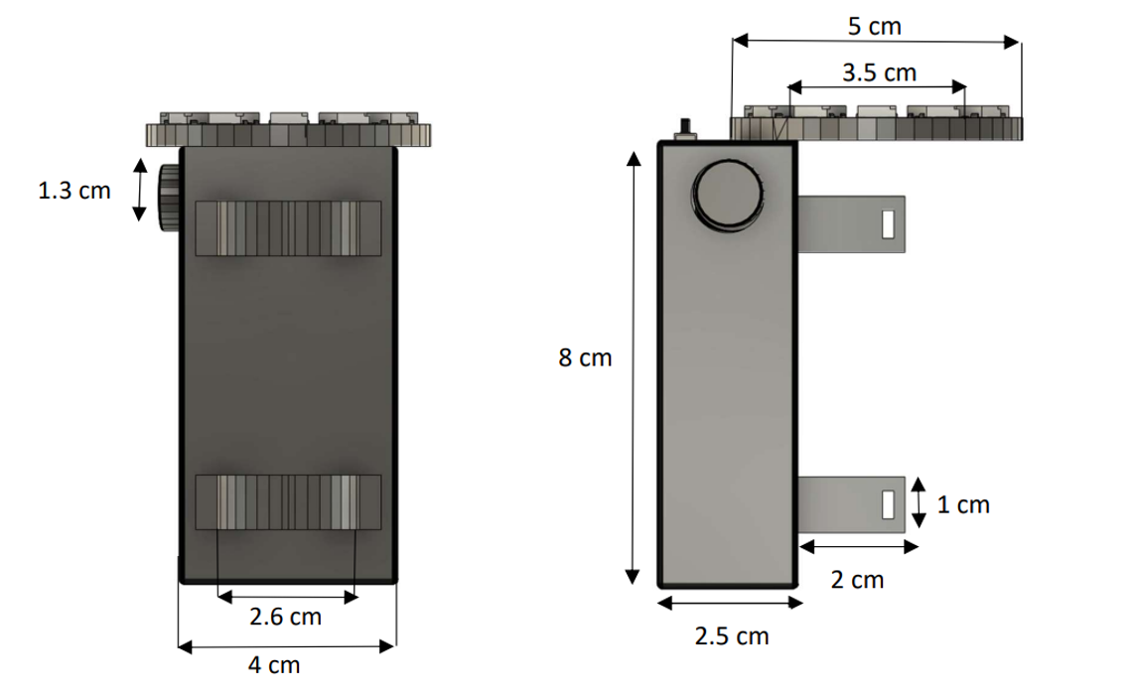
Sweeper Device Dimensions
Small form factor and lightweight design does not impede gameplay
Fits around all standard curling brooms
Additional cut-outs for a Velcro strap, offering increased support.
Adjustable Broom Location

Slide 17
Sweeper Device
1
Specifications: Sukhmeet
Make a big impact with professional slides, charts, infographics and more.
Project Motivation and Stakeholders
Design Specifications
2
Technology & Skip Device: Tony
Make a big impact with professional slides, charts, infographics and more.
Technology used
Skip Device Features
3
Sweeper Device: Mo
Make a big impact with professional slides, charts, infographics and more.
Display Signals
Sweeper Device Features
4
Marketing: Corben
Make a big impact with professional slides, charts, infographics and more.
Components and Costs
Market Overview and Business Strategy
5
Conclusion: Mo
Make a big impact with professional slides, charts, infographics and more.
Takeaways and future considerations
Audience Questions

Slide 18
Marketing
1
Specifications: Sukhmeet
Make a big impact with professional slides, charts, infographics and more.
Project Motivation and Stakeholders
Design Specifications
2
Technology & Skip Device: Tony
Make a big impact with professional slides, charts, infographics and more.
Technology used
Skip Device Features
3
Sweeper Device: Mo
Make a big impact with professional slides, charts, infographics and more.
Display Signals
Sweeper Device Features
4
Marketing: Corben
Make a big impact with professional slides, charts, infographics and more.
Components and Costs
Market Overview and Business Strategy
5
Conclusion: Mo
Make a big impact with professional slides, charts, infographics and more.
Takeaways and future considerations
Audience Questions

Slide 19
Device Components & Bundle Cost
Skip Device Cost
Sweeper Device Cost
Additional Costs
Component | Price
ESP 32 | $4.58
Joystick | $1.04
Case | $0.58
Push-Button | $2.64
Total | $9.11
Component | Price
ESP 32 | $4.58
LED ring | $1.21
Switch | $0.25
Case | $0.58
Push-Button | $2.64
Total | $9.26
Manufacturing cost | $13.50
Marketing cost | $3.44
Distribution cost | $11.00
Total Bundle Cost: Skip Device Cost + 2*Sweeper Device Cost + Additional Costs = $55.57

Slide 20


Product Pricing
Team Bundle
Curling Club Bundle
Master Meetup Bundle
2 Sweeper Devices
1 Skip Devices
Standard Package
10 Sweeper Devices
5 Skip Devices
Incentivizes larger purchases
Targeted at clubs
20 Sweeper Devices
10 Skip Devices
Targeted at larger organizations
$69.99
10% Discount
20% Discount
25.9% margin on Team Bundle
Individual devices also available

Slide 21
Market Demographics
~80% of curlers live in Canada
Canadian Curlers:
1,986,000
Our Business mainly targets Canadians
553,000 Canadian curlers played 10+ times a season
Only 15,000 play competitively
Based on hearing loss statistics for this group, only 10-30,000 people would realistically consider our product
Our Market size dictates business operations
Frequent & Competitive Curlers: 568,000
Hard of hearing Curlers:
~10,000 to 30,000

Slide 22
Promotion Plan
Different Strategies we’ll take to increase sales and grow our brand
01
02
03
04
05
Assistive/medical devices are tax deductible
Offer a proportional rebate based on generated activity from product post/ endorsements
Use website data to email reminders and discounts to potential customers which do not complete their transactions.
Offer in-person demos
Partner with curling clubs, organizations, and equipment manufacturers
Provide referral codes upon sales
Reward partial refunds or store credit for future purchases
Social media provides low-cost public interaction
Use Google or Facebook advertising to directly target users
Multilevel
Marketing
Customer
Incentives
Online marketing
& Social Media
In-Person &
Partnerships
Retargeting

Slide 23
Marketing
1
Specifications: Sukhmeet
Make a big impact with professional slides, charts, infographics and more.
Project Motivation and Stakeholders
Design Specifications
2
Technology & Skip Device: Tony
Make a big impact with professional slides, charts, infographics and more.
Technology used
Skip Device Features
3
Sweeper Device: Mo
Make a big impact with professional slides, charts, infographics and more.
Display Signals
Sweeper Device Features
4
Marketing: Corben
Make a big impact with professional slides, charts, infographics and more.
Components and Costs
Market Overview and Business Strategy
5
Conclusion: Mo
Make a big impact with professional slides, charts, infographics and more.
Takeaways and future considerations
Audience Questions

Slide 24
Conclusion
1
Specifications: Sukhmeet
Make a big impact with professional slides, charts, infographics and more.
Project Motivation and Stakeholders
Design Specifications
2
Technology & Skip Device: Tony
Make a big impact with professional slides, charts, infographics and more.
Technology used
Skip Device Features
3
Sweeper Device: Mo
Make a big impact with professional slides, charts, infographics and more.
Display Signals
Sweeper Device Features
4
Marketing: Corben
Make a big impact with professional slides, charts, infographics and more.
Components and Costs
Market Overview and Business Strategy
5
Conclusion: Mo
Make a big impact with professional slides, charts, infographics and more.
Takeaways and future considerations
Audience Questions

Slide 25
Future Considerations
Low power mode
Add a low power mode to devices to reduce power consumption when not in use, and further maximize energy efficiency.
Cloud connectivity
Allow users to store and access game data and statistics, connect with other players, and participate in online curling communities.
Revamping the exterior
Fix the skip device to have a more compact design. Also, Improve clamp design that allows for a more secure and stable attachment to the broom handle, and easier internal Access.
Vibrational feedback
Consider adding a vibrational motor to the device to provide users with a tactile feedback when a signal is sent.

Slide 26
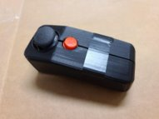
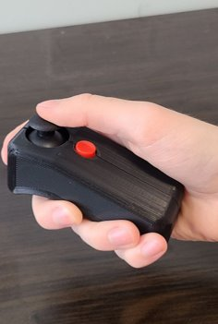
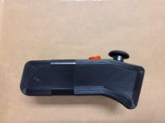
Skip’s Single Handheld Controller

Slide 27
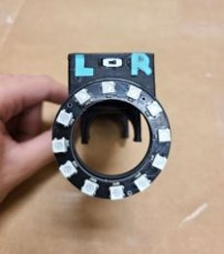
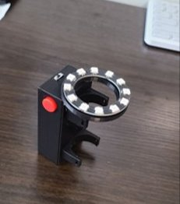
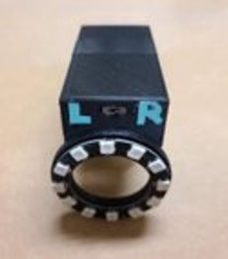
Sweeper’s Broom Mountable LED Ring

Slide 28
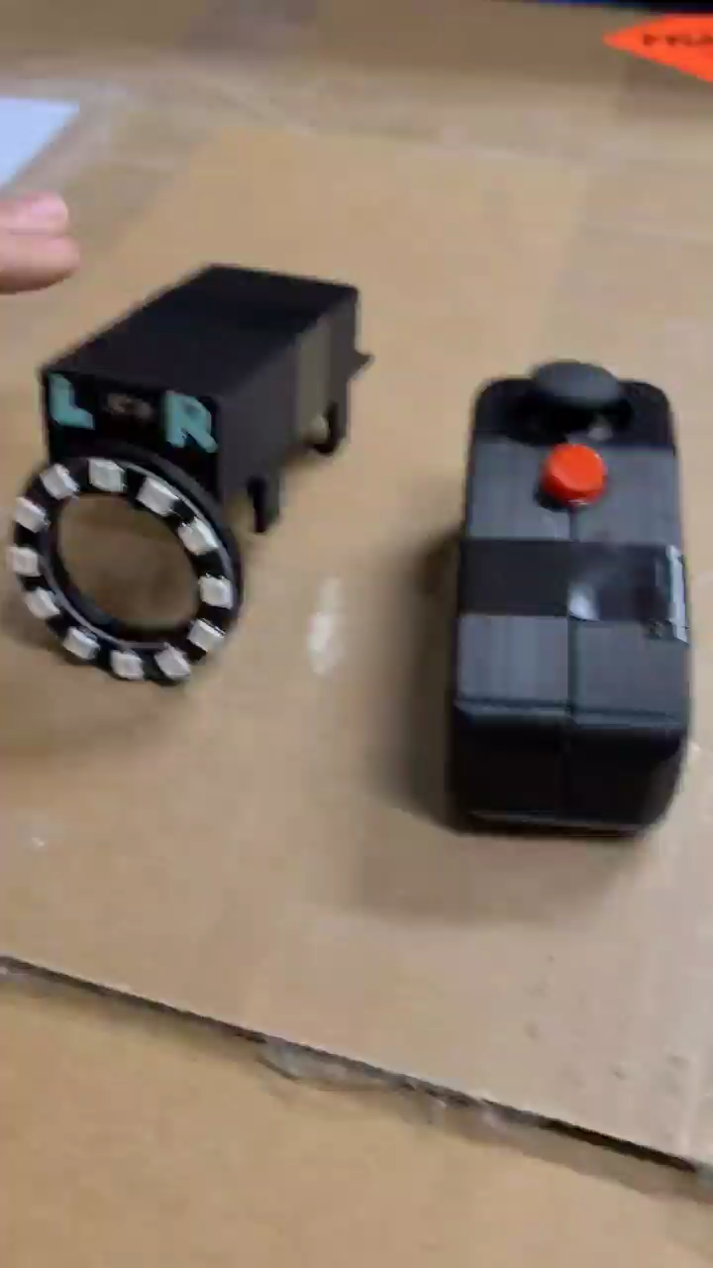
Demonstration

Slide 29

Thanks for Listening
Any Questions or Concerns?

